Slide 1
Swift Youth Foundation – Volunteer Contact Form
Team 26
Opportunity Hack 2018
Austin Lamb, David Baxter, Saul Lopez, Kaeli Grey, Cuahuctemoc Osorio

Slide 2
Problem Statement
Current Process for Non Profit Organizations is inefficient with regards to tracking, communicating, and scheduling for volunteers.
Can alienate volunteers and prevent further participation.
This makes it hard for Organizations to find volunteers, they can end up with too few people or way too many people showing up.

Slide 3
Scope of Problem
We can automate a lot of the work they are currently doing.
Swift could benefit from a volunteering communication platform.
Want to easily communicate with volunteers and possibly integrate into current systems while not requiring large technical knowledge.
Currently uses paper forms to track who signs into Volunteer Events and has to add them into Salesforce manually for each attendee.

Slide 4
Our Solution
Custom Website
Can provide all needed features.
Can solve problem for a wider audience.
Benefits
Gather volunteers contact info and only notify them of events they want to be notified of.
Provides easy to use calendar for adding events.
Very simple and hands off.
Provides useful statistics and handles check in at events.

Slide 5
Proposed Salesforce Solutions
Qualtrics Survey Form with Salesforce Integration
Survey platform with access to one free survey and limited Salesforce integrations. Pricing varies for all features.
Salesforce Integrated Sign In Form
Highly customizable but requires some Salesforce development knowledge.
Create Salesforce Dashboard
Can export data to Excel, to load into Remind (to send texts) - YouTube Tutorial - just copy and paste
Can view reports and charts. Lots of options to filter data.

Slide 6
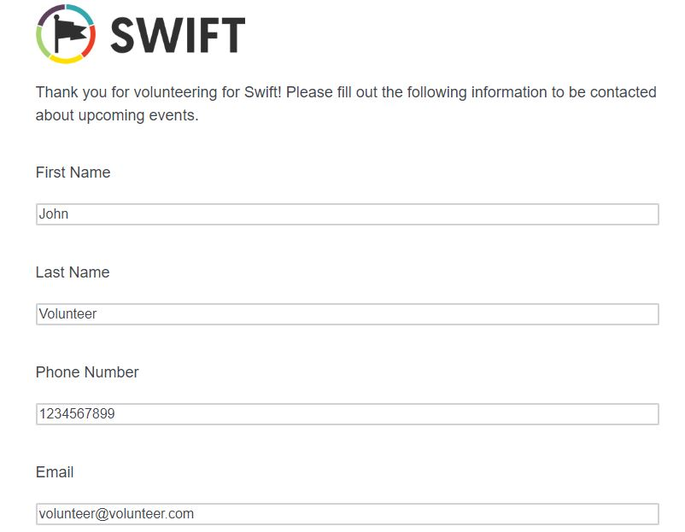
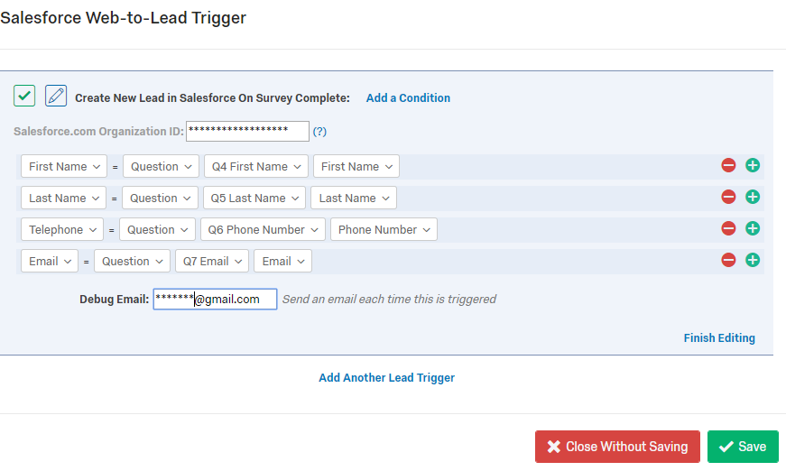
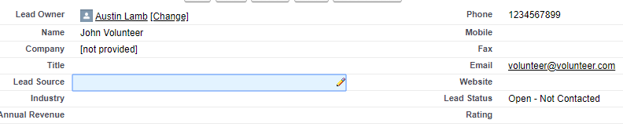
Qualtrics Survey Form with Salesforce Integration
Qualtrics Volunteer Sign Up with Salesforce Integration
Basic Example of Survey Up and Sign In
Qualtrics Settings
Resulting Salesforce Lead after survey completion

Slide 7

Integrate Form into Salesforce to track volunteering automatically as opposed to current manual process
Salesforce Integrated Sign In Form
Example Form that would load into volunteering Contact Info.
This form is on a Salesforce page but can also be a webpage
Salesforce Tutorial
Update Volunteering Hours in Salesforce

Slide 8
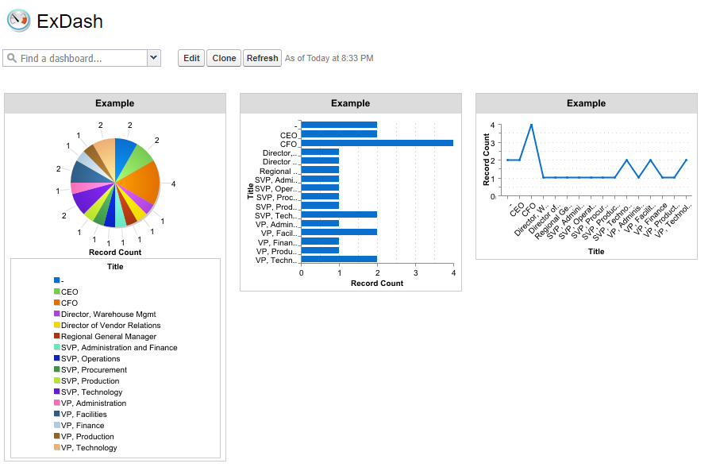
Highly customizable dashboard for summary view of Salesforce Data
Create Salesforce Dashboard

